Slide 1
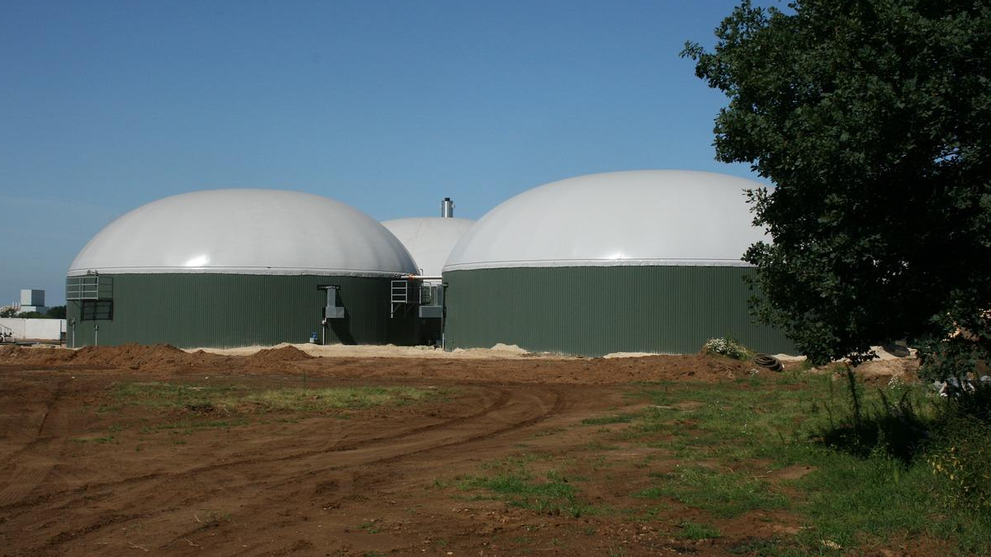
BIOGAS OVERVIEW IN BRAZIL
Challenges & Opportunities
March 2021
Rubens Aebi

Slide 2
BIOGAS DEVELOPMENT IN NUMBERS
65+ new biogas powerplants were built in Brazil
More than R$ 700 million in investments (US$ 125 million) in 19/20
50 MW injected in the grid only in 2020
Equivalent to around 100 million m3 of biomethane/ year produced

Slide 3
BRAZILIAN PROJECTS DISTRIBUTED IN 2020

Slide 4
OVERALL KIND OF INVESTMENTS
Majority: Private projects -> Focus of agrobusiness cooperatives
Most of animal origin. Why? Further income/ waste solution
Biggest Market -> Sugarcane Market showed the biggest expansion
Market Increase: 84% (2015 - 2019)
Units increase: 126 – 548 units (2020)

Slide 5
MARKET POTENTIAL
SUGARCANE: potential to produce +57 million m3 /day
ANIMAL PROTEIN: potential ro produce +35 million m3/day
SANITATION: potential to produce +6 million m3/day
CURRENT STATUS:
Biogas production in Brazil (2020): 1.5 billion m3/ year
(Less than 4% of the current fossil fuels production)
Estimated potential: +40 billion m3/ year

Slide 6
BIOGAS & ELECTRICITY MARKET
Most projects current focus on electricity generation due to incentives in the so called “Distributed Generation” for powerplants until 5 MW;
Soon the possibility of new opportunities to sell energy in the coming energy auctions from the government (A-3 and A-4) in june 2021;
There are also good perspectives for the “hour price” of energy, which is not attached to energy contracts;
New coming hybrid projects (biogas + solar);

Slide 7
CHICKEN AND CATTLE MANURE PLANT IN PARANÁ

Slide 8
BIOMETHANE: NEW PERSPECTIVES
Although electricity is ongoing, biomethane is the biggest potential in Brazil due to its regional factors
Golar Power Distribution announed it will do a public call to buy 5 million m3/biomethane per day in 2021
This represents 16% of the projected national demand in 2030;

Slide 9
SCANIA TRUCKS

Slide 10
New Holland Tractors
CHICKEN AND CATTLE MANURE PLANT IN PARANÁ

Slide 11
BIOGAS & MUNICIPAL SOLID WASTE (MSW)
Current Market situation:
Power generation by biogas thermal plants from urban waste grew 7.7% in 2020, reaching 110.2 average MW produced, according to the CCEE (Chamber of Commercialization of Electric Energy).
The process, advanced 162% in five years, says CCEE, which registers 18 plants in Brazil, six of which are in São Paulo, where the highest concentration is.

Slide 12
1ST BIOGAS FROM ORGANIC WASTE IN BRAZIL

Slide 13
INFRASTRUCTURE AND JENSBACHER GENERATORS

Slide 14
29 MW LANDFILL BIOGAS POWERPLANT IN SP

Slide 15
OVERVIEW OF THE 21 GENERATORS

Slide 16
CURRENT CHALLENGES AND MARKET GAPS
Lack of industrial suppliers for operation and post-sales problems;
High costs due to import taxes and dependence of international suppliers
Potential depends clearly on the organic material being explored, which can still vary from region to region in Brazil;
There are still main logistic problems;
Ex: Sugarcane plants can cost around R$50 -100 million (US$8.9 – 20 million) depending on its size and region.
Poor separation of organic waste from the population (MSW).

Slide 17
THANK YOU VERY MUCH
Come to Brazil and join us in the Brazilian biogas market!
Rubens Aebi – ABREN 2021

